Slide 1
Network Layer Overview

Slide 2
Purpose
Main aim:
To deliver “packets” between endpoints over multiple links
The main layer 3 device is called a router
Hosts send packets
Routers forward packets
5 | Application
4 | Transport
3 | Network
2 | Data Link
1 | Physical

Slide 3
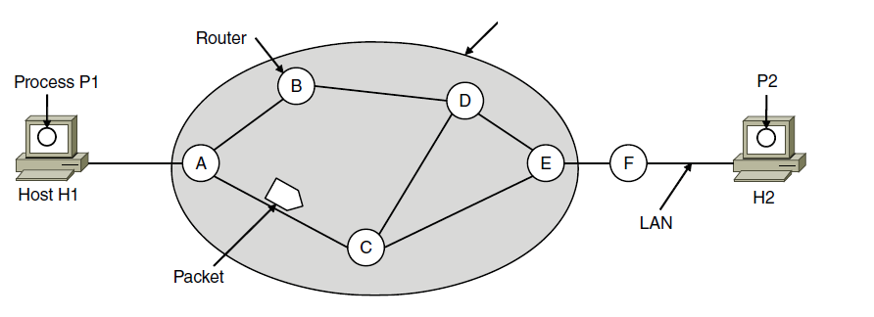
Store-and-Forward Packet Switching
ISP’s equipment
The environment of the network layer protocols.

Slide 4
Services Provided to the Transport Layer
Services independent of router technology.
Transport layer shielded from number, type, topology of routers.
Network addresses available to transport layer use uniform numbering plan
even across LANs and WANs

Slide 5
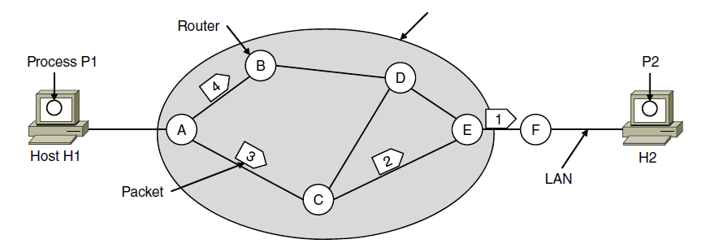

Connectionless Service (Datagrams)
ISP’s equipment
A’s table (initially) A’s table (later) C’s Table E’s Table
Forwarding based on Destination Address
Different packets: Possibly different paths

Slide 6
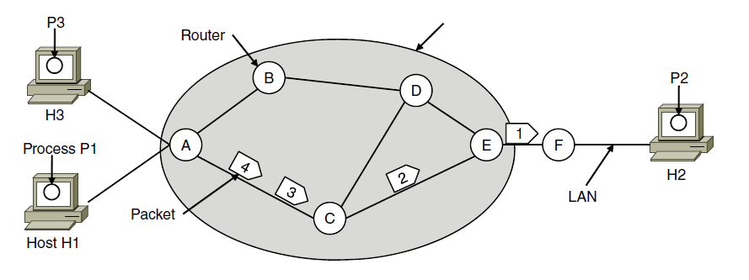

Connection-Oriented Service (Virtual Circuits)
ISP’s equipment
1
2
2
2
1
1
1
1
A’s table C’s Table E’s Table
VC setup in advance
Forwarding based on VC tag
Different packets: Same path

Slide 7
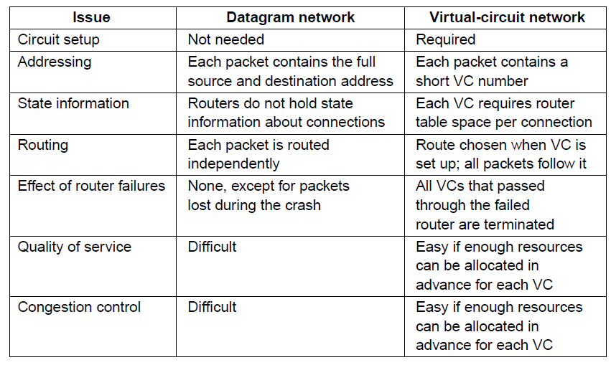
Virtual-Circuit vs Datagram Networks

